Slide 1
Signal Processing
2018S ESE 2014 [B114] Digital Signal Processing and Storage

Slide 2
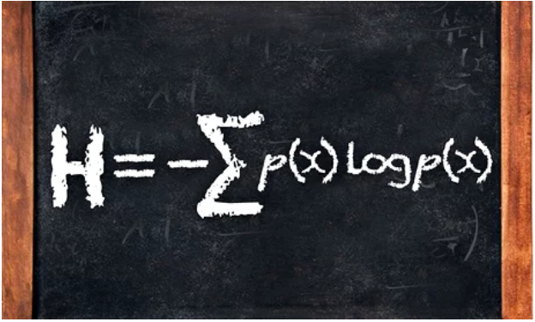

Slide 3
Without Claude Shannon's information theory there would have been no internet
It showed how to make communications faster and take up less space on a hard disk, making the internet possible
This equation was published in the 1949 book The Mathematical Theory of Communication, by Claude Shannon.
An elegant way to work out how efficient a code could be, it turned "information" from a vague word related to how much someone knew about something into a precise mathematical unit that could be measured, manipulated and transmitted.
It was the start of the science of "information theory", a set of ideas that has allowed us to build the internet, digital computers and telecommunications systems.
When anyone talks about the information revolution of the last few decades, it is Shannon's idea of information that they are talking about.
Notes:
https://www.theguardian.com/science/2014/jun/22/shannon-information-theory

Slide 4
During the second world war, Shannon worked on codes and methods of sending messages efficiently and securely over long distances, ideas that became the seeds for his information theory.
Before information theory, remote communication was done using analogue signals. Sending a message involved turning it into varying pulses of voltage along a wire, which could be measured at the other end and interpreted back into words. This is generally fine for short distances but, if you want to send something across an ocean, it becomes unusable.
Every metre that an analogue electrical signal travels along a wire, it gets weaker and suffers more from random fluctuations, known as noise, in the materials around it. You could boost the signal at the outset, of course, but this will have the unwanted effect of also boosting the noise.
Notes:
https://www.theguardian.com/science/2014/jun/22/shannon-information-theory

Slide 5
TOPICS
Analysis and representation of continuous-time, discrete-time and linear time-invariant systems
Theory and practice of difference equations, discrete-time convolution, the z-transform, discrete-time Fourier Transform and the Fast Fourier Transform algorithm
Implement finite-impulse response and infinite-impulse response filters
DAC and ADC theory and application
Design and implement an application that computes the discrete Fourier Transform using the Fast Fourier Transform(FFT)algorithm

Slide 6
Differentiate continuous and discrete in time signals and the representation of continuous signals as discrete signals
1.1 Describe the differences between analog and digital signals.
1.2 Describe introductory concepts of digital signal filtering.
1.3 Identify elements of a digital signal processing system.
1.4 Explain differences between low-pass, high-pass, band-pass and band-reject filtering.
1.5 Describe differences between continuous time, discrete time, continuous valued and discrete valued
signals.
1.6 Explain sampling and quantization of signals

Slide 7
Describe discrete time and LTI systems and compute the convolution and correlation of discrete time LTI signals.
2.1 List elementary discrete-time signals.
2.2 Explain the difference between energy and power signals.
2.3 Explain differences between periodic and aperiodic signals and even and odd signals. 2.4 Explain differences between time-invariant and time-variant and linear and non-linear systems.
2.5 Describe the meaning of causal and non-causal systems.
2.6 Explain the importance of linear time invariant systems.
2.7 Explain the purpose of the convolution formula.
2.8 Compute the correlation between two signals.

Slide 8
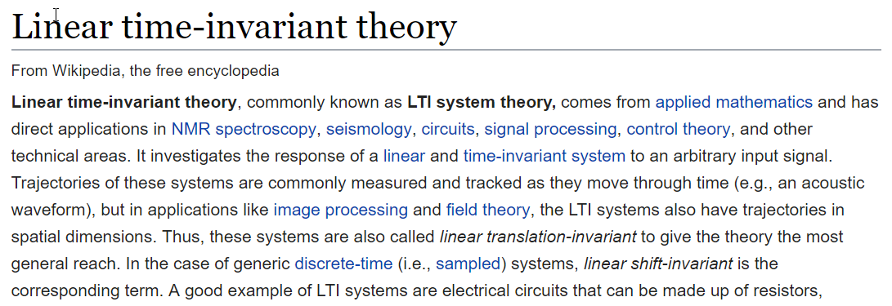

Slide 9
Determine the frequency response of an LTI system.
4.1 Determine the frequency response of LTI systems.
4.2 Calculate and plot the magnitude and phase response of a LTI system.
4.3 Sketch the pole-zero plot of a LTI system.
4.4 Sketch the magnitude plots of Fourier transforms based on the pole-zero sketch of a LTI system.
Notes:
https://ocw.mit.edu/courses/electrical-engineering-and-computer-science/6-02-introduction-to-eecs-ii-digital-communication-systems-fall-2012/readings/MIT6_02F12_chap12.pdf

Slide 10
Design and implement FIR and IIR digital filters.
5.1 Design FIR filters.
5.2 Determine and plot the magnitude and phase response of FIR filters.
5.3 Design IIR filters.
5.4 Determine and plot the magnitude and phase response of IIR filters.
5.5 Sketch z-plane pole-zero plots for digital filters.
5.6 Determine the system function based on z-plane pole-zero plots.
Notes:
https://ocw.mit.edu/courses/electrical-engineering-and-computer-science/6-341-discrete-time-signal-processing-fall-2005/lecture-notes/lec08.pdf
http://www.mee.tcd.ie/~corrigad/3c1/DSP1_2012_students.pdf

Slide 11
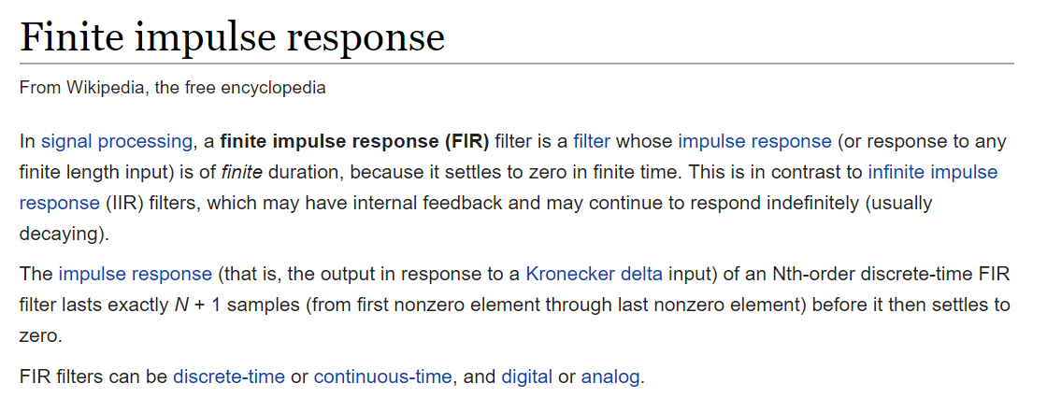

Slide 12
Convert analog signals to digital signals and digital signals to analog signals.
6.1 Draw a diagram of a basic analog to digital converter.
6.2 Draw a diagram of a basic digital to analog converter.
6.3 Describe the meaning of sampling a continuous signal.
6.4 Describe the meaning of quantization of a continuous signal.
6.5 Describe the meaning of digitizing a continuous signal.

Slide 13
Implement C++ applications to filter and process audio signals.
7.1 Add a reverberation effect to an audio signal.
7.2 Add an echo effect to an audio signal.
7.3 Add a chorus effect to an audio signal. 7.4 Add a phaser effect to an audio signal.
7.5 Add a flanger effect to an audio signal.
7.6 Remove noise from an audio signal.

Slide 14
Implement C++ applications to filter and process images.
8.1 Add a blurring effect to a 2-D image signal.
8.2 Remove a blurring effect from a 2-D image signal.

